Slide 1
Smart Shrimp Farming
IN 1900 (ICT Project)
Interim Presentation
Group No: 31
(Noble Team)

Slide 2
Group Members
No | Index No | Name
01 | 204192X | Sara A.N. Z
02 | 204130H | Megasuriya M.M.A.M.J
03 | 204006J | Appuhamy H.D.S.A.N
04 | 204171H | Rajapaksha S.S.D
05 | 204155M | Perera J.K.A.T

Slide 3
Problem in brief
Although shrimp farming gives a huge amount of progress in the economy, the shrimp farmers face more challenges to achieve their expected goals.
▪ Manual monitoring and lack of maintaining proper record
▪ Necessity for more man power
▪ Hard to maintain the growth of shrimps
▪ Lack of knowledge in maintaining the quality of water

Slide 4
Aim & Objectives
Aim
Design and devolop the system to assist our local shrimp farmers in easing their work and saving their time.
Objectives
To help the farmer to control and monitor the shrimp ponds from a distance .
To feed the shrimps automatically with a proper record of time and mass.
To monitor the consumption of food easily.
Monitoring the cultivation using the pH, Temperature, Mass of food and Date and Time schedule of feeding shrimps.
To operate motors and lamps automatically with a phone.
To monitor the quality and control the level of water

Slide 5
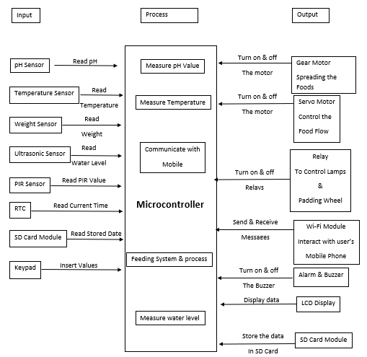
Proposed Solution

Slide 6
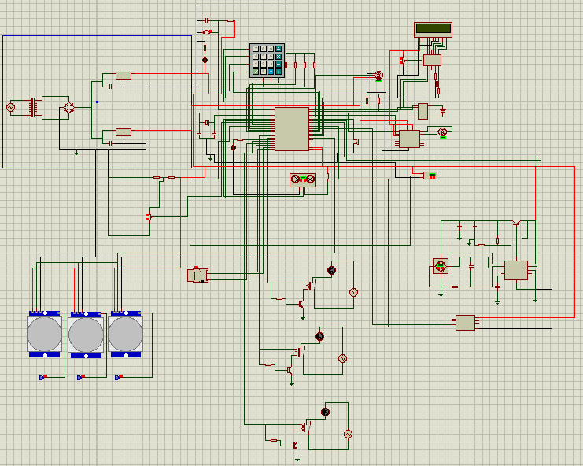
Full Circuit

Slide 7
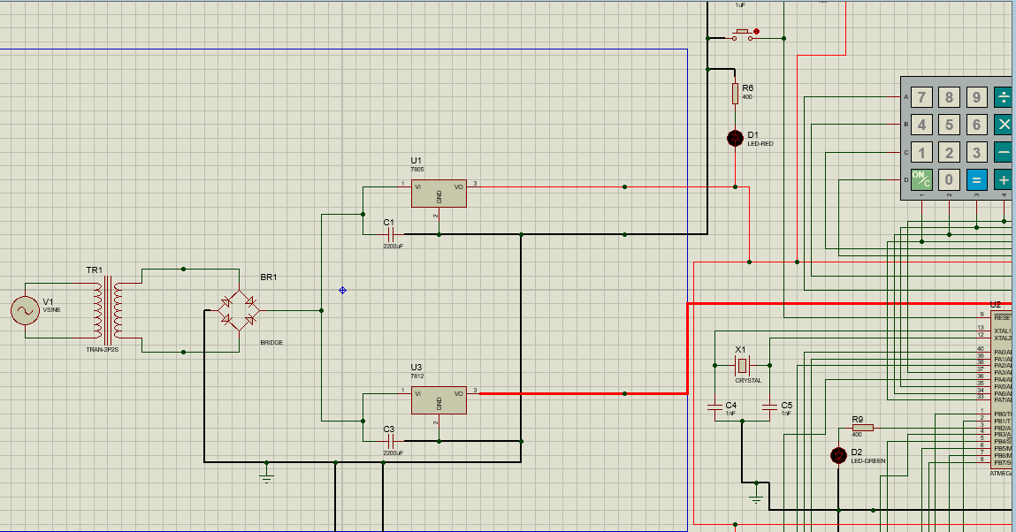
Full Circuit Cont.

Slide 8
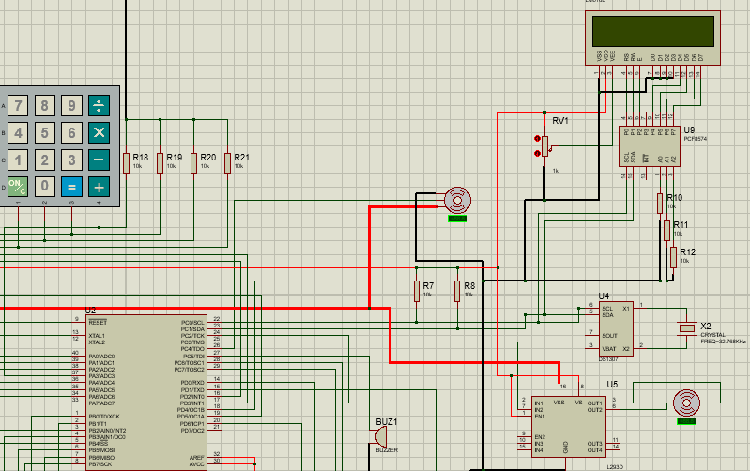
Full Circuit

Slide 9
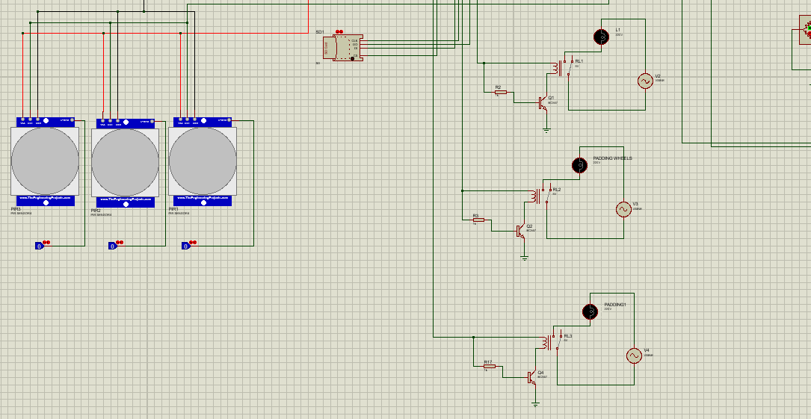
Full Circuit

Slide 10
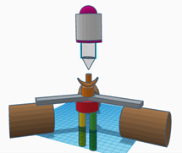
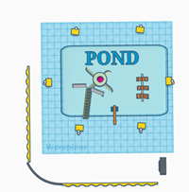
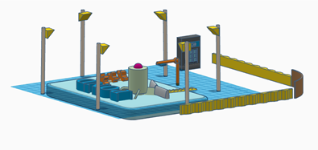
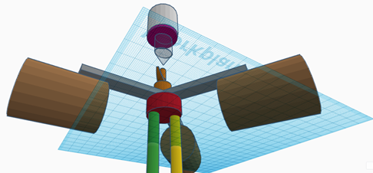
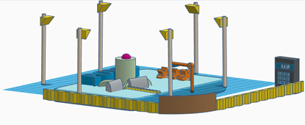
3D Diagram

Slide 11
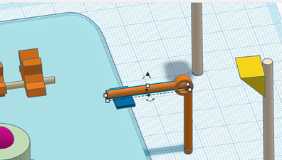
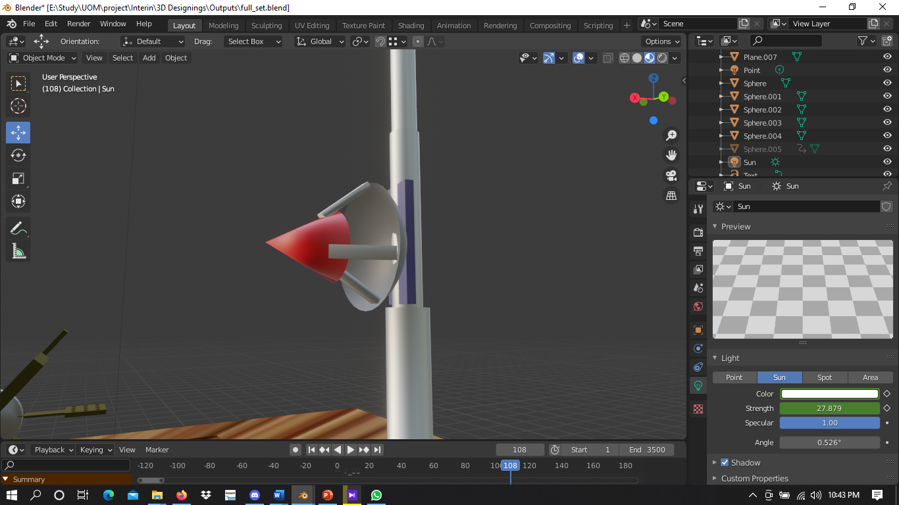
3D Diagram Cont.
PIR Sensor

Slide 12
Resources Required
Software:
● Atmel Studio
● Proteus
● Blender
Hardware:
1. Sensors
● pH sensor
● Temperature sensor
● Weight sensor
● Ultrasonic sensor
2. Relay
3. Atmega32 Controller
4. Real Time Clock Module
5. SD card Module
6. Buzzer
7. Spreading Motor
8. Servo Motor
9. Keypad
10. LCD Display

Slide 13
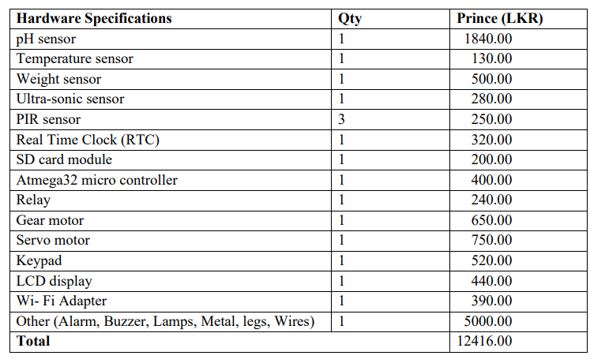
Estimated Cost

Slide 14
Individual
Contribution

Slide 15
Member 01: Sara A.N.Z- 204192X
Our hardware project is to construct a shrimp feeding system. I discovered what needed to be done by communicating with my project partners, attending hardware project meetings, and conducting research. First, we drafted the proposal by explaining our problem and the suggested solution. Throughout those days, I learned about the technologies that we want to use to develop the system.
● Learning about servo motor
● Learning to simulate using Proteus
● Learning to do 3D animation
I have learnt to develop interfacing servo motors, the structure of it and how it could be used in our project and to design and code a servo motor. I too learnt to use Proteus software to simulate the circuit. I too learnt to make 3D animations using Blender.

Slide 16
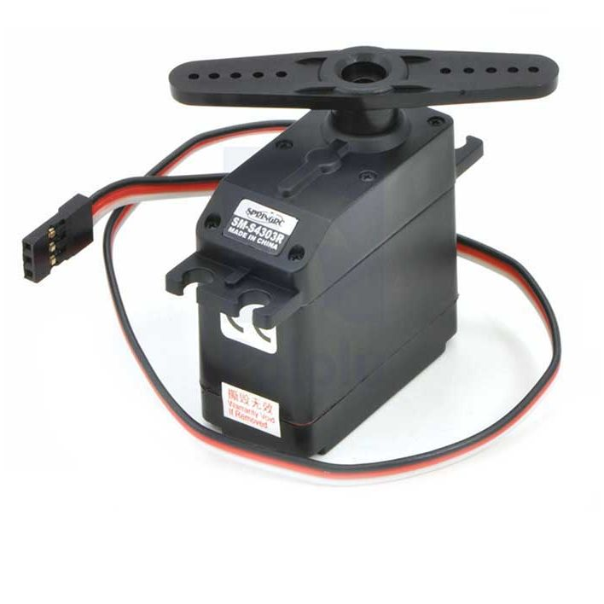
Servo Motor
Maximum Voltage = 6V
Maximum Current = 100mA
Pin = 03
VCC
Ground
Signal
Link for Data sheet : https://www.tme.eu/Document/004105658202ef89808bba102ca4bf3f/POLOLU-1248.pdf

Slide 17
Code
#ifndef F_CPU
#define F_CPU 8000000UL // 16 clock speed
#endif
#include <avr/io.h>
#include <util/delay.h>
int main(void)
{
DDRC = 0x16; //Makes RC0 output pin
PORTC = 0x00;
while(1)
{
//Rotate Motor to 0 degree
PORTC = 0x16;
_delay_us(1000);
PORTC = 0x00;
_delay_ms(2000);

Slide 18
//Rotate Motor to 90 degree
PORTC = 0x16;
_delay_us(1500);
PORTC = 0x00;
_delay_ms(2000);
//Rotate Motor to 180 degree
PORTC = 0x16;
_delay_us(2000);
PORTC = 0x00;
_delay_ms(2000);
}
}

Slide 19
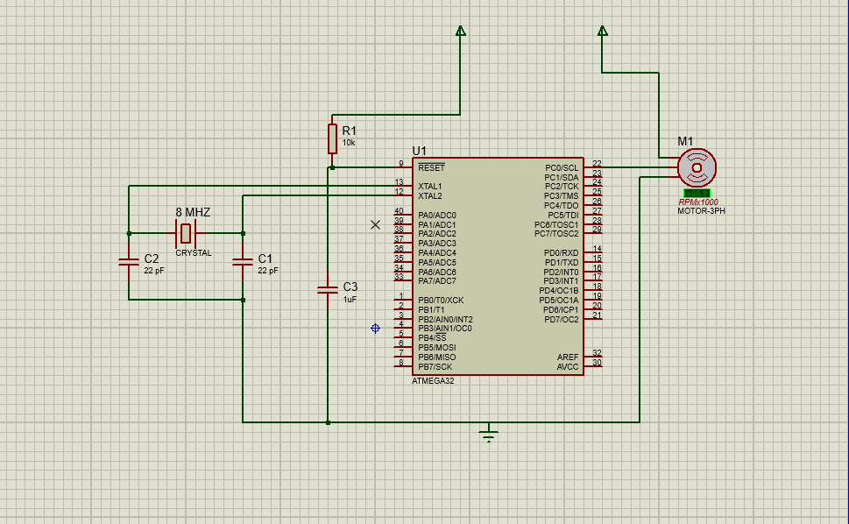
Circuit Diagram

Slide 20
Member 02: Megasuriya M.M.A.M.J- 204130H
Our hardware project will be to manufacture a shrimp feeding mechanism. I recognized what needed to be done by engaging with my project teammates, attending hardware project meetings, and conducting research. First, we drafted the proposal by explaining our problem and the suggested solution. Throughout those days, I learned about the technologies that we want to use to develop the system.
● Learning about relay and pH sensor
● Learning to simulate using Proteus
● Learning to do 3D animation
I have learnt about designing and coding a relay and a pH sensor.learnt to use Proteus software to simulate the circuit. I too learnt to make 3D animations using Blender

Slide 21
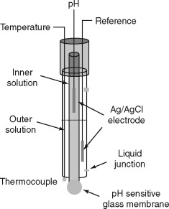
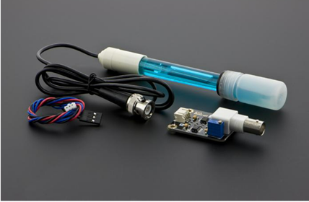
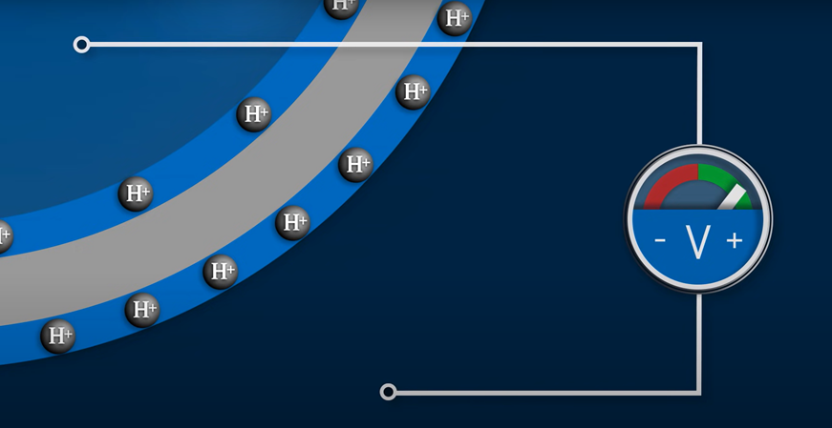
pH sensor
Link for data sheet -https://datasheetspdf.com/pdf/1415405/Vernier/pH-Sensor/1

Slide 22
pH Cont.
Maximum Voltage-5V
Maximum current-

Slide 23
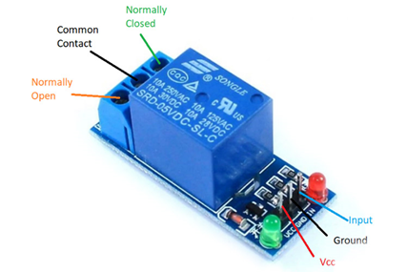
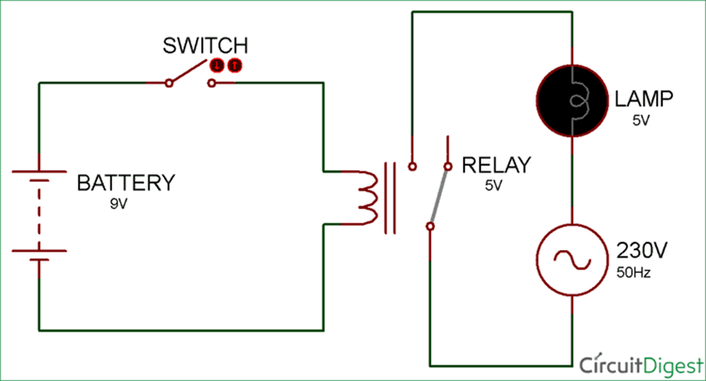
Relay circuit

Slide 24
#include<reg52.h>
sbit relay_pin = P2^0; gives a variable name to port 2
void Delay_ms(int); predefines the delay function
void main()
{
do // loop to contineously switch the relay
{relay_pin = 0;
Delay_ms(1000);
relay_pin = 1;
Delay_ms(1000);
Maximum voltage-12 V
Maximum current-200 mA
void Delay_ms(int k) // function to generate delay
{
int j;
int i;
for(i=0;i<k;i++)
{
for(j=0;j<1275;j++)
}
}

Slide 25
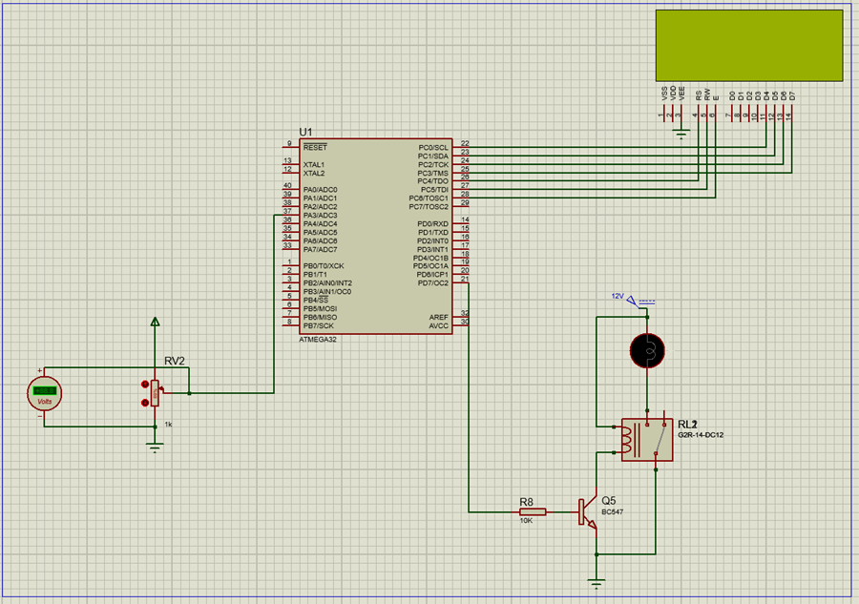
Circuit diagram
Link for data sheet-https://components101.com/sites/default/files/component_datasheet/5V%20Relay%20Datasheet.pdf

Slide 26
Member 03: Appuhamy H.D.S.A.N- 204006J
Manufacturing a shrimp feeding device will be our hardware project. By interacting with my project partners, attending hardware project meetings, and completing research, I was able to identify what needed to be done. We begin by drafting the proposal by describing our problem and the proposed remedy. I learnt about the technology we intend to employ to construct the system during the course of those days.
● Learning about real time clock module(RTC)
● Learning to simulate using Proteus
● Learning to do 3D animation
I have learnt about designing and coding an alarm system used with RTC module. I mention that I have learnt to use Proteus to design the circuits and learned to create 3D animations using Blender. I'm also working on a WIFI module. At the time, I was mainly concerned with the theoretical aspects of this wifi module, as well as figuring out how to connect to the atmega32.

Slide 27
Responsibilities
Learn about how RTC work
How to connect RTC to the atmega32 microcontroller
Learn about how wifi adapter work
How to connect to wifi adapter to atmega32 microcontroller
Refer the code parts of following components
Identifying what are the method that use for communicate with microcontrollar .
Learning to do 3D animations

Slide 28
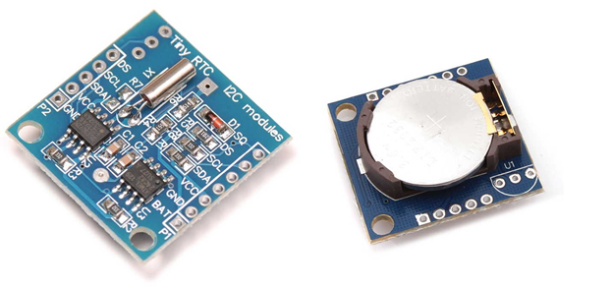
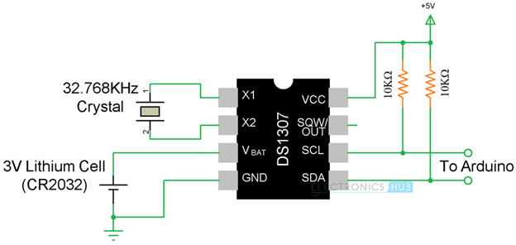
RTC (Real Time Clock Module)
Specification (ds1307):
Low power full BCD clock/calender
2 main power sources can be connected.
Maximum voltage of primary supply is 5.5v.
Minimum voltage of primary supply is 4.5v.
Maximum voltage of secondary supply is 3.5v.
Minimum voltage of secondary supply is 2.0v.
Maximum current is 1.5mA.
Connecting via I2c protocol.
Link to datasheet https://pdf1.alldatasheet.com/datasheet-pdf/view/58481/DALLAS/DS1307.html

Slide 29
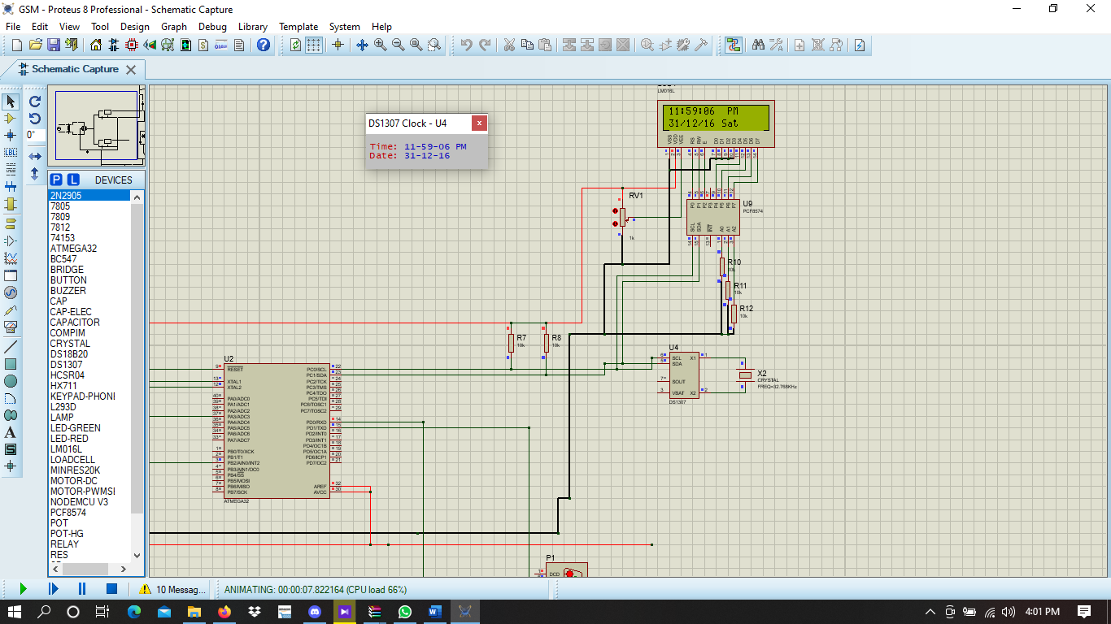
Circuit Diagram

Slide 30
Code
void I2C_INIT_FUN(I2C_Handler_t * Handler)
{
// INIT. i2c peripheral
I2C->I2C_TWBR = ((((uint64_t)F_CPU)/(uint64_t)(Handler->Init.I2C_Clk_Speed))-16)/2;
I2C->I2C_TWAR = Handler->Init.I2C_SlaveADD;
I2C->I2C_TWCR = 0x00 ;
I2C->I2C_TWSR = 0x00 ;
if(Handler->Init.I2C_INIT_MODE == I2C_INIT_EN)
{
sei();
I2C->I2C_TWCR |= 0x01 ;
}else{
I2C->I2C_TWCR &= ~0x01 ;
}
}

Slide 31
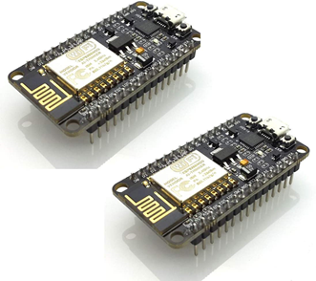
WIFI Module
Specification (esp 8226):
Maximum Voltage is 3.6v.
Minimum voltage is 3.0v.
Maximum current is 12mA.
UART Protocol is use in here for transfer data.
Link to datasheet https://www.electroschematics.com/wp-content/uploads/2015/02/esp8266-datasheet.pdf

Slide 32
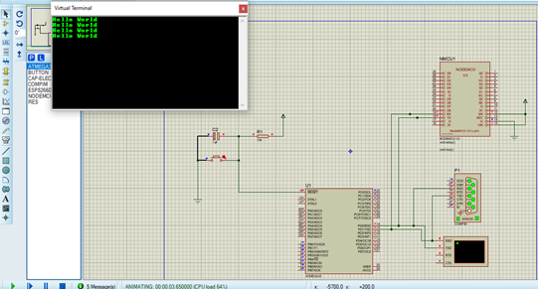
Circuit Diagram

Slide 33
Code
#include <avr/io.h>
#include <avr/delay.h>
#include <avr/interrupt.h>
#define F_CPU 16000000UL //Freq -> 1MHz
#define BAUDRATE 9600
#define BAUD_PRESCALLER (((F_CPU / (BAUDRATE * 16UL))) - 1)
void UART_init_U2X(){
UCSRA = (1<<U2X); // SELECT DOUBLE SPEED
UCSRB = (1<<RXEN)|(1<<TXEN)|(1<<RXCIE); //RX TX
UCSRC = (1<<URSEL)|(1<<UCSZ1)|(1<<UCSZ0);
UBRRH = 0x00;
UBRRL = BAUD_PRESCALLER;
sei(); //Enable Global Interrupt
}
void UART_Tchar(unsigned char data)
{
UDR = data;
while((UCSRA&(1<<TXC)) ==0);
}
void UART_Tstr(char *p)
{
while(*p){
UART_Tchar(*(p++));
_delay_ms(1);
}
}

Slide 34
Member 04: Rajapaksha S.S.D- 204171H
Our hardware project will be to build a shrimp food mechanism. I had no idea what I had to accomplish at first. However, after interacting with my project teammates and engaging in hardware project meetings, as well as reading research, I realized what needed to be done. First, we draft the proposal by stating our problem and the recommended remedy. I learnt about the technology that we aim to employ to build the system throughout those days.
I've learnt a lot of new things. Not only the study-related things, but also how to operate in a team and interact with team members

Slide 35
Responsibilities
About gear motor and how it works
How to connect gear motor to the atmega32 microcontroller
About weight sensor and how it works
How to connect to weight sensor to atmega32 microcontroller
Refer the code part of them
Identifying devices needed to when connecting to those sensors to atmega32 microcontroller
Learning to do 3D animations

Slide 36
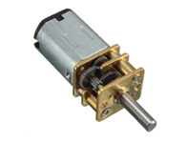
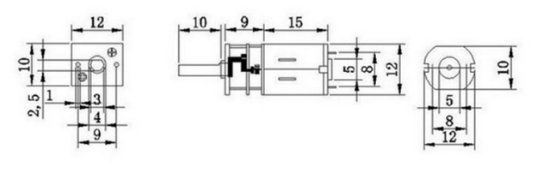
Gear Motor
Specifications:
Rated Voltage : 12V Model:GA12-N20
Revolving Speed : 200 RPM
Load Speed : 80 RPM
Rated Torque : 2 kgcm
Stall Torque : 16 kgcm
Rated Current : 70 mA
Stall Current : 1 A
Gear Material : Full Metal
Link to Data sheet:
https://www.handsontec.com/dataspecs/GA12-N20.pdf

Slide 37
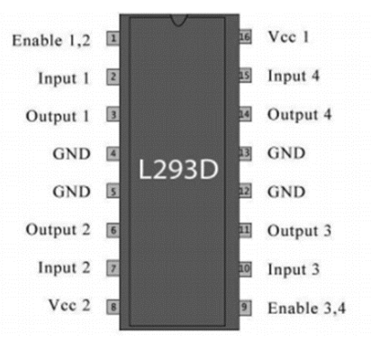
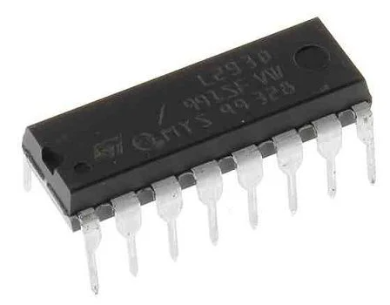
L293D Motor Driver
Specifications:
Type: Half Bridge
Operating Supply Voltage: 4.5 V to 36 V
Output Current :600 mA
Operating Supply Current: 2 mA
Minimum Operating Temperature: - 40 C
Maximum Operating Temperature: + 150 C
Unit Weight: 270 mg
Number of Outputs: 2 Output
Link to the Data sheet:
https://cdn-shop.adafruit.com/datasheets/l293d.pdf

Slide 38
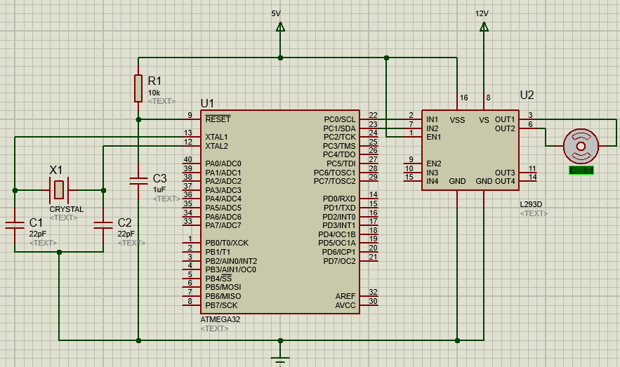
Circuit Diagram

Slide 39
Code
#ifndef F_CPU //check is available F_CPU
#define F_CPU 16000000UL // 16MHz clock speed
#endif //End of the if function
#include <avr/io.h> //Include std. library file
#include <util/delay.h> //Include delay header file
int main(void)
{
DDRC = 0xFF; //PORTC as Output
while(1)
{
//Rotates Motor in Antilockwise
PORTC = 0x01; //00000001
_delay_ms(4000);
//Stops Motor
PORTC = 0x00; //00000000
_delay_ms(4000);
//Rotates Motor in Clockwise
PORTC = 0x02; //00000010
_delay_ms(4000);
//Stops Motor
PORTC = 0x03; //00000011
_delay_ms(4000);
}
}

Slide 40
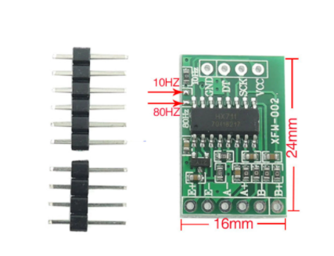
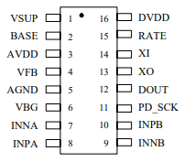
Weight Sensor / HX711 Module
Specifications :
Maximum current: <1.5 mA
Operation supply Voltage range: 2.7 ~ 5.5V
Operation temperature Range: -40~+85
Weight: 5g
Link to refer Speciation Data Sheet:
https://cdn.sparkfun.com/datasheets/Sensors/ForceFlex/hx711_english.pdf

Slide 41
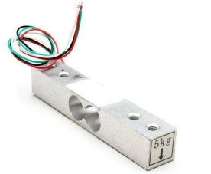
Load Cell /YZC-131A
Specifications :
Insulation Resistance: 2000MΩ
Excitation Voltage: 5V
Recommended Operating Voltage: 5V
Maximum Operating Voltage: 10V
Material: Aluminum
Rated Load: 1Kg, 2Kg, 3Kg, 5Kg
Input Impedance: 1000 ohm
Output Impedance: 1000 ohm
Link to refer Speciation Data Sheet:
https://www.electronicoscaldas.com/datasheet/YZC-131A.pdf

Slide 42
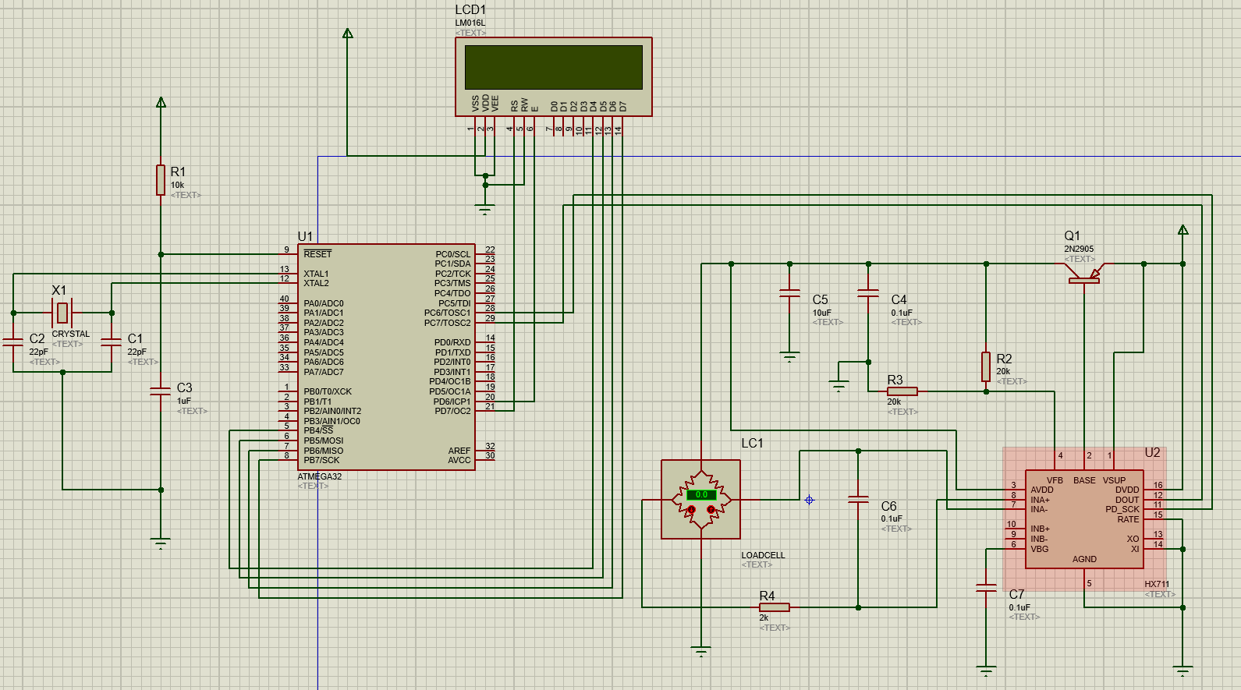
Circuit Diagram

Slide 43
Member 05: Perera J.K.A.T- 204155M
Learning about SD card module
Learning to simulate using Proteus
Learning to do 3D animation
Our hardware project will be to manufacture a shrimp feeding mechanism. I recognized what needed to be done by engaging with my project teammates, attending hardware project meetings, and conducting research. First, we draft the proposal by stating our problem and the recommended remedy. I learnt about the technology that we aim to employ to build the system throughout those days. I gathered theoretical knowledge on SD card module

Slide 44
Thank You
Questions

